Slide 1
IFN 649 Presentation
Sujung Son (Krystal) n11482117

Slide 2
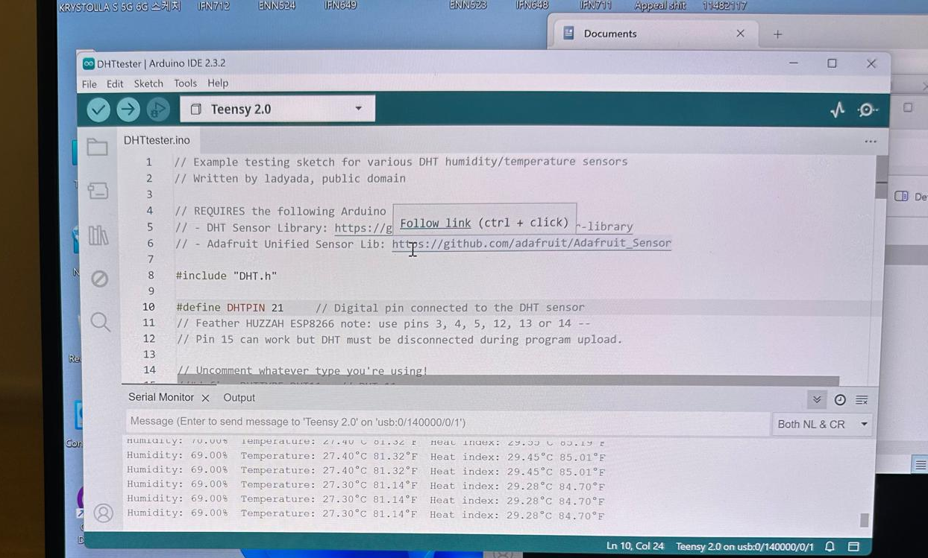
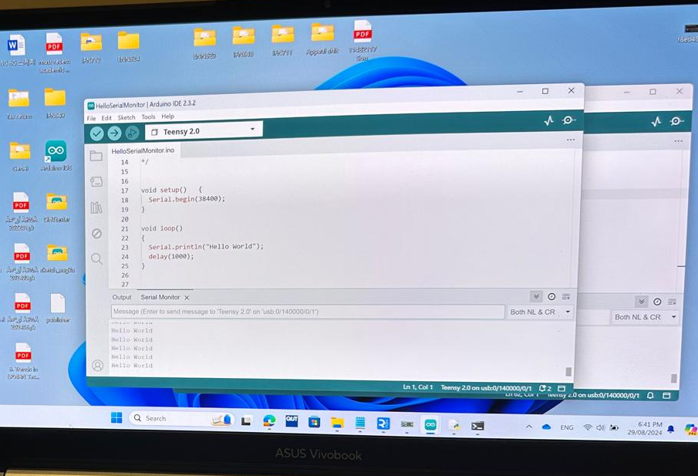
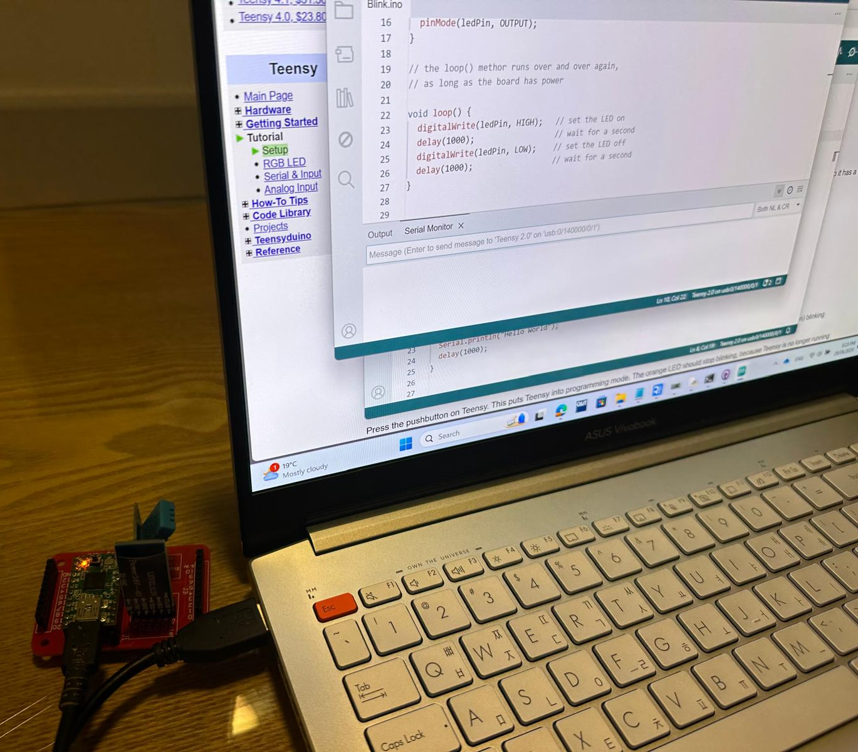
W1 : Blink LED, Print temperature and humidity on serial terminal
Hello World using serial port
Reading temperature and humidity using DHT-11 sensor
LED blinks on Teensy

Slide 3
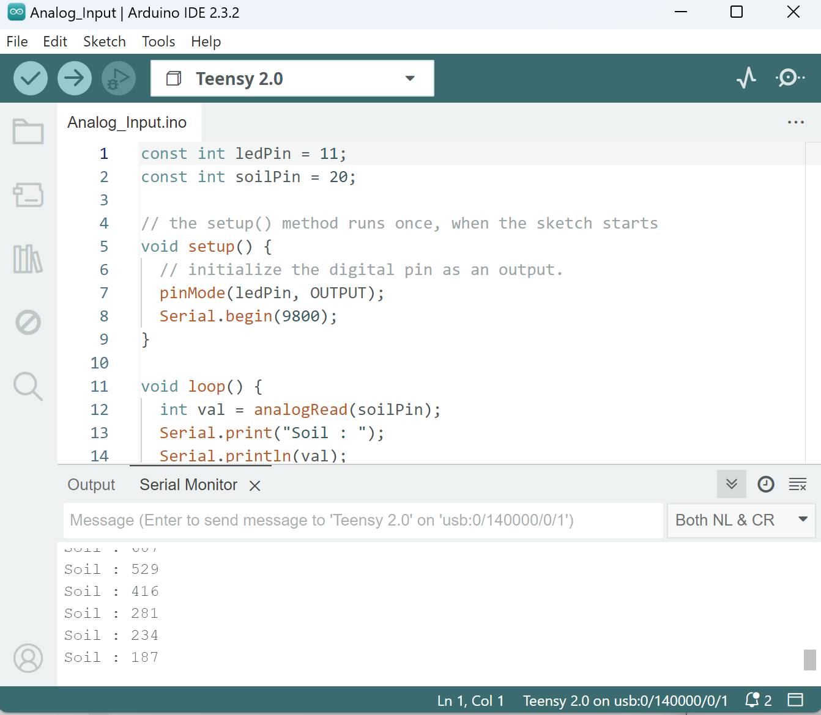
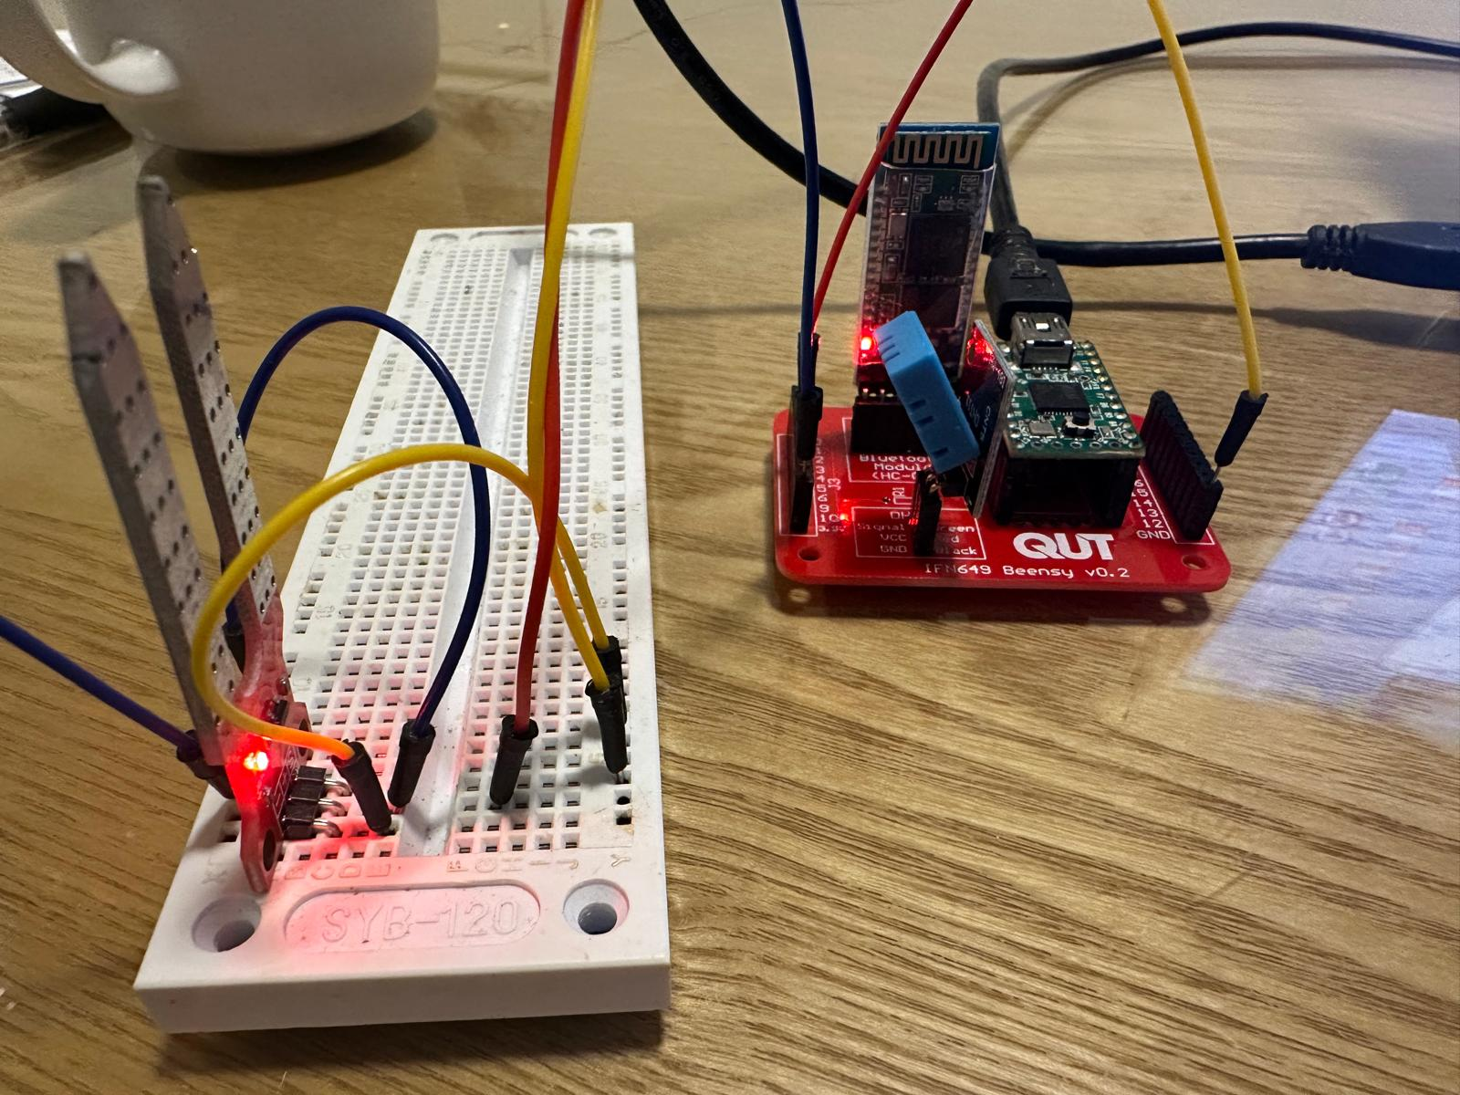
W2 : Soil Moisture Sensor, HC-05 Bluetooth
Communication with Laptop

Slide 4
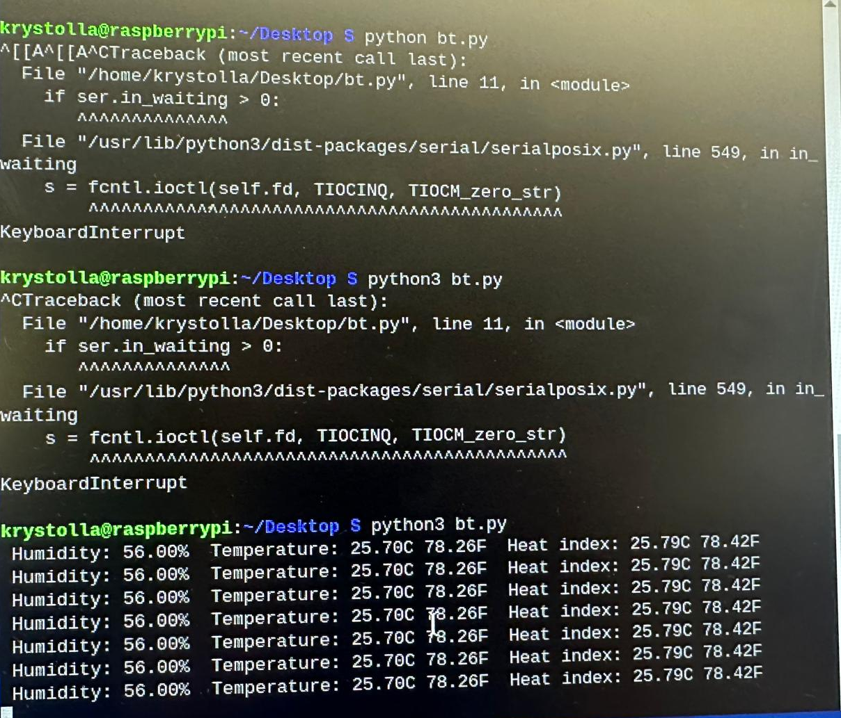
W3 : Communication between Raspberry Pi and Teensy
Communication with Teensy

Slide 5
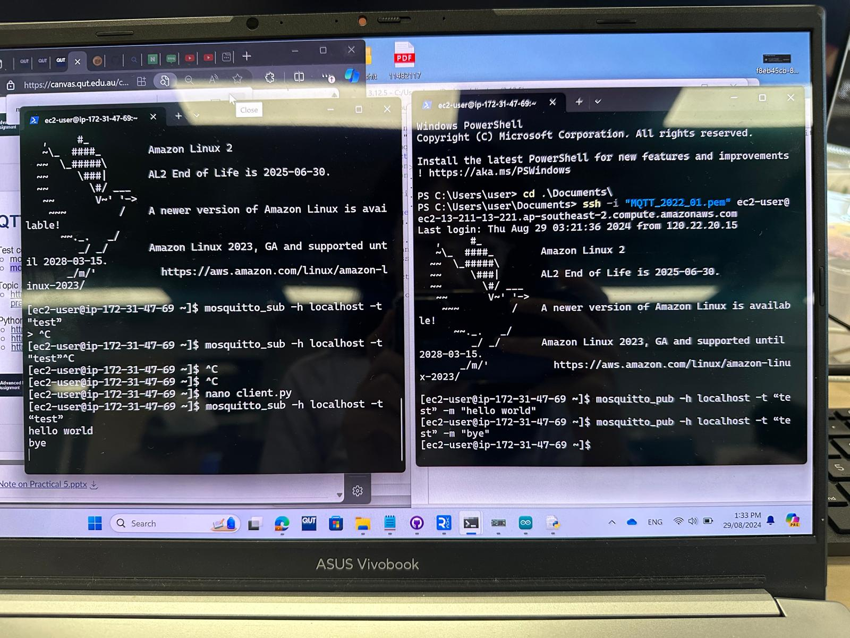
W4 : Connect to AWS instance and Install MQTT on AWS
Installation Test terminal 1 - mosquitto_sub -h localhost -t "test” terminal 2 - mosquitto_pub -h localhost -t test -m "hello world”

Slide 6
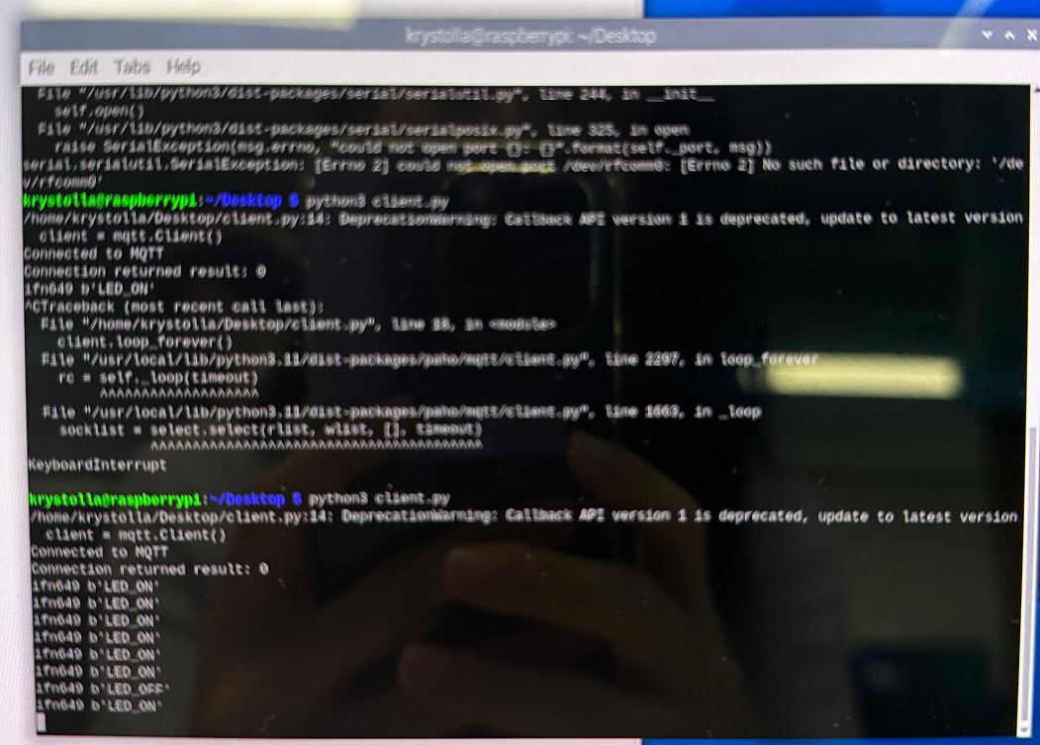
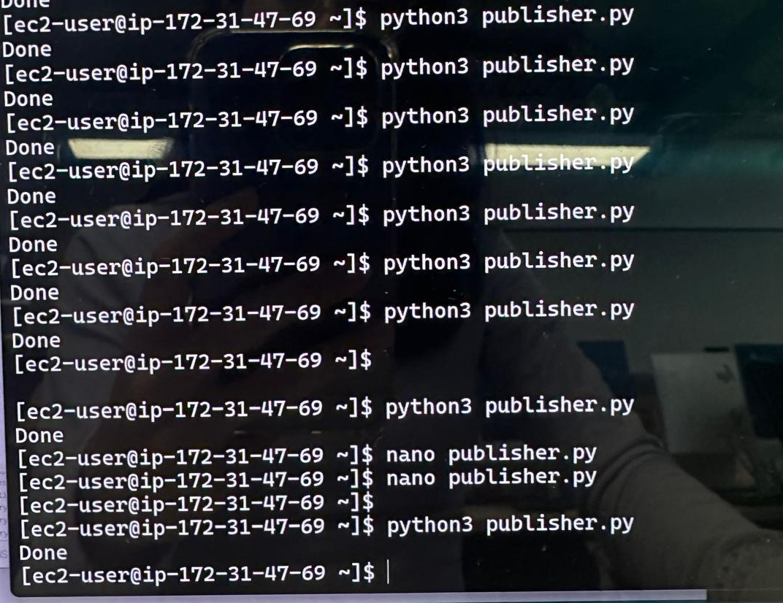
W5 : Downstream communication (AWS tier – Edge tier – Sensing tier)
Communication between Raspberry Pi and AWS using MQTT - Subscribing/Publishing Topics using Python
Downstream communication - Receiving Command from Cloud/edge tiers

Slide 7
Github link

